Slide 1
SSQSA
present and future
Gordana Rakić, Zoran Budimac
Department of Mathematics and Informatics
Faculty of Sciences
University of Novi Sad
goca@dmi.rs, zjb@dmi.rs

Slide 2
Outline
SSQSA mission
Brief description of SSQSA framework
Applicability of SSQSA
SSQSA in research and education
Conclusion

Slide 3
SSQSA Set of Software Quality Static Analyzers
Objectives
Overall:
consistency of software quality analysis when applied to the source code written in different computer languages
In particular
to provide set of static software analyzers to ensure, check and consequently increase the quality of modern software products
Two important features of the framework:
Adaptability of the framework to different input languages
Extensibility of the available set of analysis with new analysis algorithms as needed
… based on its main characteristic
language independency based on eCST (enriched Concrete Syntax Tree) representation of source code

Slide 4
Outline
SSQSA mission
Brief description of SSQSA framework
Applicability of SSQSA
SSQSA in research and education
Conclusion

Slide 5
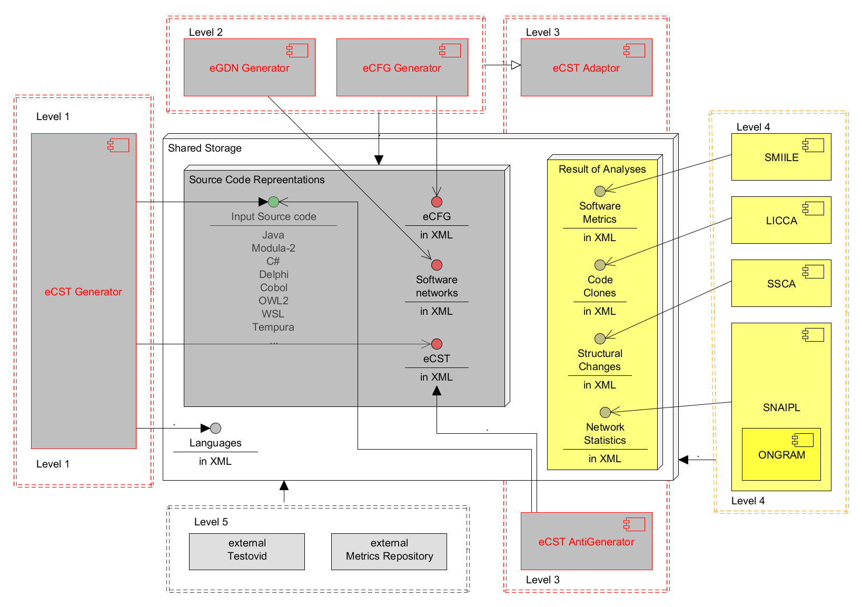
SSQSA architecture
5
Notes:
Slika placeholder

Slide 6
SSQSA architecture
LEVEL I: SSQSA front-end
eCST Generator
source code → set of eCSTs
eCSTs created by parsers generated by ANTLR
LEVEL II:
Generators of derived internal representations
eGDN Generator
eCFG Generator
LEVEL III: SSQSA eCST manipulators
eCST Antigenerator
eCST Adaptor
6
6

Slide 7
SSQSA architecture
LEVEL IV: SSQSA back-ends (SSQSA tools)
Static analysis tools that use eCST representation
SNAIPL software network analyzer
SSCA software structure change analyzer
SMIILE software metrics calculator
LICCA for code clones
LEVEL V: Integration of SSQSA tools with other tools
Tools that use outputs of SSQSA tools
Testovid
Metrics repository
7
7

Slide 8
SSQSA architecture
8
Notes:
Slika placeholder

Slide 9
Adaptability to a new language
Translate the language specification to grammar in ANTLR notation (write the ANTLR grammar)
Add a rule for syntax tree generation to the grammar (rewrite the rules),
Add the universal nodes to the syntax tree (extend the rules),
Generate the parser and the scanner
Add language to the XML configuration file for supporting languages
9

Slide 10
Extendibility to a new analysis
Define the set of universal nodes needed to implement wanted algorithm,
If necessary add the new nodes
To catalog
To existing ANTLR grammar as it is described before (for all languages),
If grammar has been modified generate the scanner and the parser (for all languages),
Traverse the eCST
Use the incorporated universal nodes to accomplish the analysis.
10

Slide 11
Outline
SSQSA mission
Brief description of SSQSA framework
Applicability of SSQSA
SSQSA in research and education
Conclusion

Slide 12
Applicability of SSQSA
Three interconnected area of application:
In industry
Quality monitoring and control in real-life software projects
In science
Improvement of features of SSQSA framework
In education
By involving students in development of SSQSA components
Consequently students are learning specific concepts by practical work
By involving SSQSA in assessment of students’ solutions

Slide 13
Outline
SSQSA mission
Brief description of SSQSA framework
Applicability of SSQSA
SSQSA in research and education
Conclusion

Slide 14
Intermediate representations, graph and tree structures (usage and manipulation), etc.
Computer languages, programming techniques and paradigms, compiler construction, etc.
Software quality and static analysis (algorithms, implementations, tools, standards, etc)
XML technologies,
alternative storage solutions, etc.
Alternative architectural and design solutions, reengineering, refactoring, testing, validation, advanced application, etc.
14
Notes:
Slika placeholder

Slide 15
SSQSA in research and education
Subjects:
ATSE,
student project,
seminar paper X (x depends on semester)
theses, etc.
Until 2014
More that 30 successful students
Bachelor, master and doctoral
Novi Sad, Maribor, Budapest and Skoplje
More than 15 research papers

Slide 16
SSQSA in research and education ATSE 2014/2015
ATSE: Advanced Topics in Software Engineering
Static Timing Analysis (Timing Analysis on Code Level)
Goal:
to implement and integrate estimation of WCET: Worst Case Execution Time
Team work
1 PhD student
3 Master students

Slide 17
SSQSA in research and education ATSE 2014/2015
WCET is estimated based on possible execution paths
eCFG manipulation was required

Slide 18
SSQSA in research and education ADP 2014/2015
ADP: Architecture, Design and Patterns
SSQSA as a case study
PART 1: Architecture
Propose an architecture for software quality monitoring and assurance portal
! students still do not know real SSQSA architecture
!! some differences are made between real SSQSA and required portal
PART 2: Refactoring
Refactor a SSQSA component (previously developed by other students and full of bad smells)
PART 3: Design Patterns
Propose usage of design patterns in specific SSQSA functionality (component)
! students have access to an implementation without design patterns

Slide 19
SSQSA in research and education ADP 2014/2015
ADP: Architecture, Design and Patterns
Professor: Vladimir Kurbalija
Students
49 active students
46 passed practical part (invited for an oral exam)
30 passed whole exam
older than 3rd year of studies (usually 4th)
Master (and sometimes bachelor)

Slide 20
Outline
SSQSA mission
Brief description of SSQSA framework
Applicability of SSQSA
SSQSA in research and education
Conclusion

Slide 21
Conclusion
SSQSA is suitable platform for multiple application in research and education
Good environment for team work and “simulation” of real-life project situations
So far introduced in education through several subjects on all levels of study
Implemented collaboration between students on different levels of study
Still there are many unexploited possibilities

Slide 22
SSQSA
present and future
THANK YOU
Gordana Rakić, Zoran Budimac
Department of Mathematics and Informatics
Faculty of Sciences
University of Novi Sad
goca@dmi.rs, zjb@dmi.rs

